Slide 1

Microprocessor Systems
Lab4 – 1 Timer and Interrupt Service Routine
Prof. Ren-Shuo Liu
NTHU EE

Slide 2
Introduction
8051 provides two timers/counters which enable
  Counting external events
  Timer interrupt service routine
The two timers, Timer 0 and Timer 1, are each composed of two 8-bit registers.
  TH0, TL0: Registers of higher and lower 8 bits of Timer 0.
  TH1, TL1: Registers of higher and lower 8 bits of Timer 1.
Timer | Timer 0 |  |  |  |  |  |  |  |  |  |  |  |  |  |  |  | Timer 1
Reg. Name | TH0 |  |  |  |  |  |  |  | TL0 |  |  |  |  |  |  |  | TH1 |  |  |  |  |  |  |  | TL1
Bit NO. | 7 | 6 | 5 | 4 | 3 | 2 | 1 | 0 | 7 | 6 | 5 | 4 | 3 | 2 | 1 | 0 | 7 | 6 | 5 | 4 | 3 | 2 | 1 | 0 | 7 | 6 | 5 | 4 | 3 | 2 | 1 | 0

Slide 3
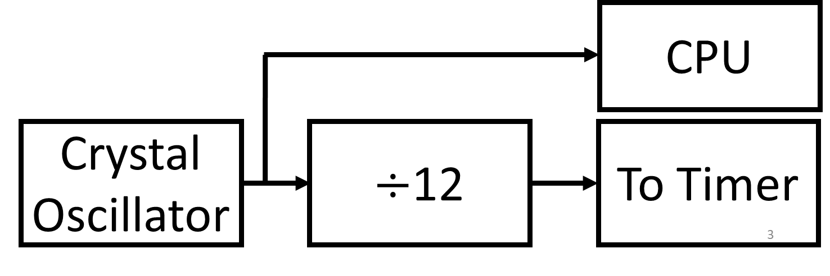
Clock
8051 takes an external crystal as the clock source of its timers. (1/12 of the crystal frequency)
An assembly instruction takes at least 12 crystal cycles to be executed, which means CPU machine cycle frequency is also 1/12 of the crystal frequency.
T= 1/(1MHz) = 1μs (one machine cycle)
12MHz
1MHz

Slide 4
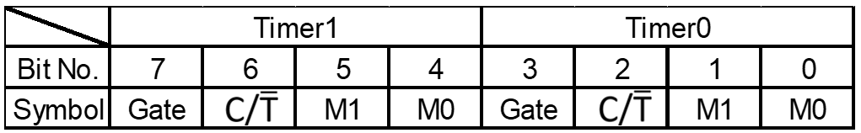
Time Mode Control Register (TMOD) Mode Selection

Slide 5
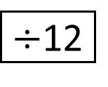
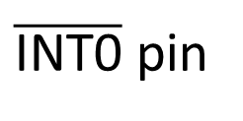
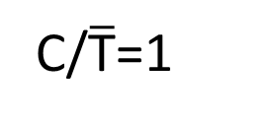
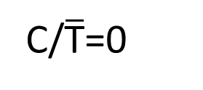
Mode 1 (16-bit Counter)
OSC
$÷$12
C/$\overline{\text{T}}$=0
TH0
(8 bits)
TL0
(8 bits)
TF0
C/$\overline{\text{T}}$=1
T0 pin
Control
Interrupt
TR0
Internal
Gate
$\overline{\text{INT}\text{0}}$ pin
External

Slide 6
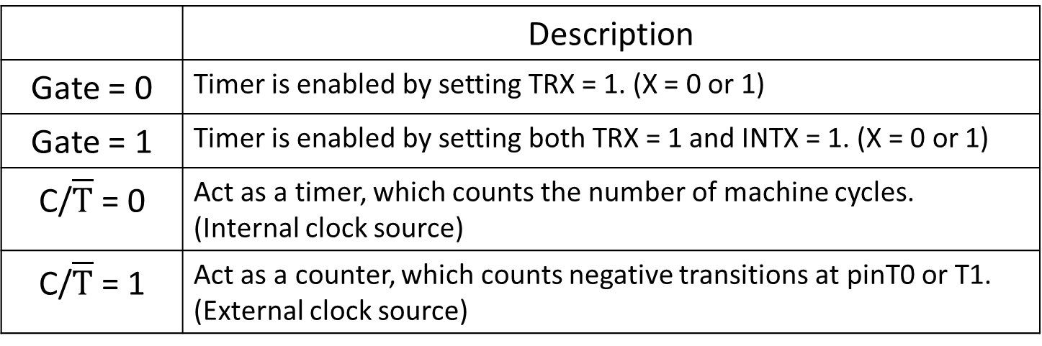
Time Mode Control Register (TMOD)
Enable and Clock Source Selection
 | Description
Gate = 0 | Timer is enabled by setting TRX = 1. (X = 0 or 1)
Gate = 1 | Timer is enabled by setting both TRX = 1 and INTX = 1. (X = 0 or 1)
C/$\overline{T}$ = 0 | Act as a timer, which counts the number of machine cycles. (Internal clock source)
C/$\overline{T}$ = 1 | Act as a counter, which counts negative transitions at pinT0 or T1. (External clock source)

Slide 7
Time Control Register (TCON)
TF0/1: Timer0/1 overflow flag
  Set by hardware when the timer overflows.
  Cleared by hardware when the interrupt routine is served.
TR0/1: Timer0/1 run control bit
  Set/Cleared by software to turn the timer on/off.

Slide 8
Time Control Register (TCON)
IE0/1: Timer0/1 interrupt enable flag
  Set by hardware when the interruption of INT0/1 is detected.
  Cleared by hardware when the interrupt routine is served.
IT0/1: Timer0/1 interrupt type
  Set to 1 means negative edge triggered.
  Set to 0 means low level triggered.

Slide 9
IE (Interrupt Enable) Register
EA | Enables/disables all interrupt
- | Reserved for future use
- | Reserved for future use
ES | Enables/disables serial port interrupt
ET1 | Enables/disables timer1 overflow interrupt
EX1 | Enables/disables external interrupt1
ET0 | Enables/disables timer0 overflow interrupt
EX0 | Enables/disables external interrupt0
9

Slide 10
Interrupt Priority
Interrupt Source | Vector address | Interrupt priority
External Interrupt 0 –INT0 | 0003H | 0
Timer 0 Interrupt | 000BH | 1
External Interrupt 1 –INT1 | 0013H | 2
Timer 1 Interrupt | 001BH | 3
Serial Interrupt | 0023H | 4

Slide 11
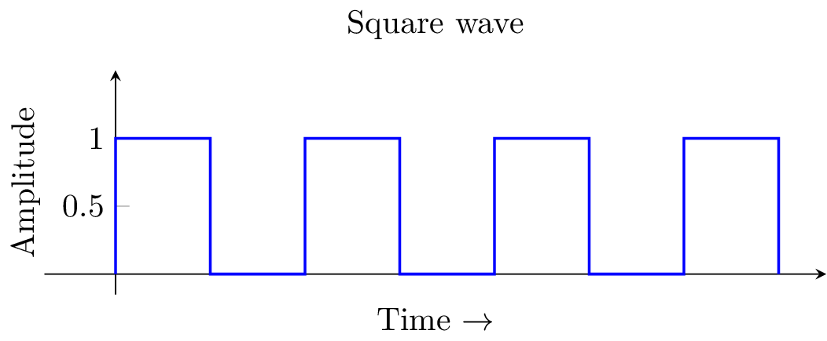
Generate a square wave of 2ms
Assume crystal oscillator frequency of 12MHz
  one timer cycle = 1μs
  count = (1ms)/(1us) = (1000us)/(1us) = 1000
1ms
1ms

Slide 12
Generate a square wave of 2ms
Take Timer0 mode1 as an example, the timer will increment from 0 ~ 65535 .
To interrupt after counting 1ms, the initial value to be set for the timer will be 1000 less than its maximum.
i.e., set initial time value to (65535-1000), and map this 16-bit value into two 8-bit registers.
TH0 = (65536-1000) / 256 = 0xFC // 8 bit quotient
TL0 = (65536-1000) % 256 = 0x18 // 8 bit remainder

Slide 13
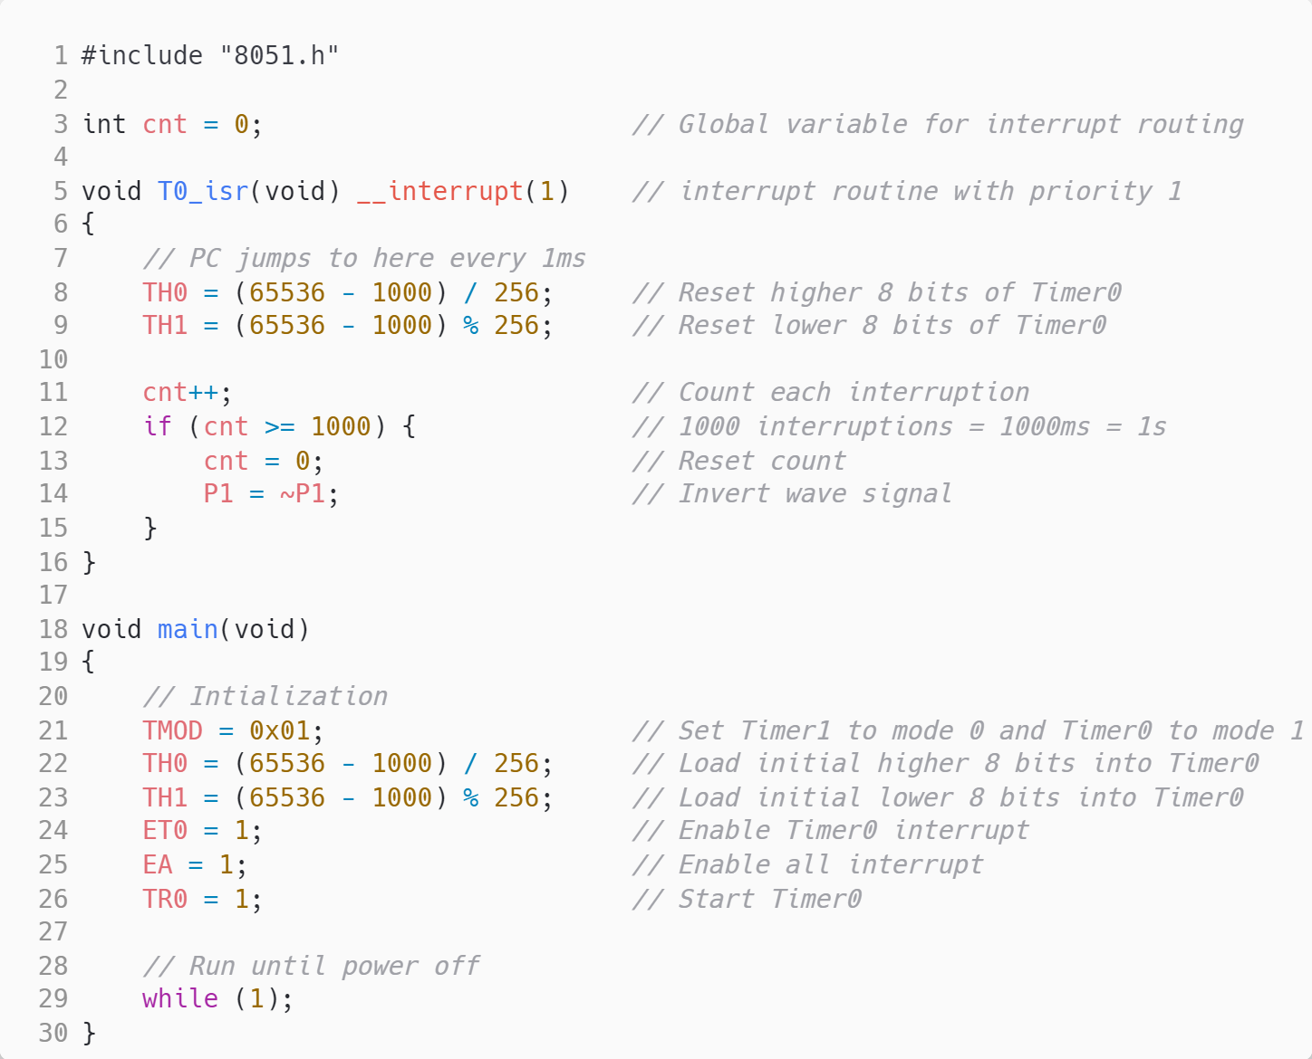
Generate a square wave of 2ms
interrupt priority

Slide 14
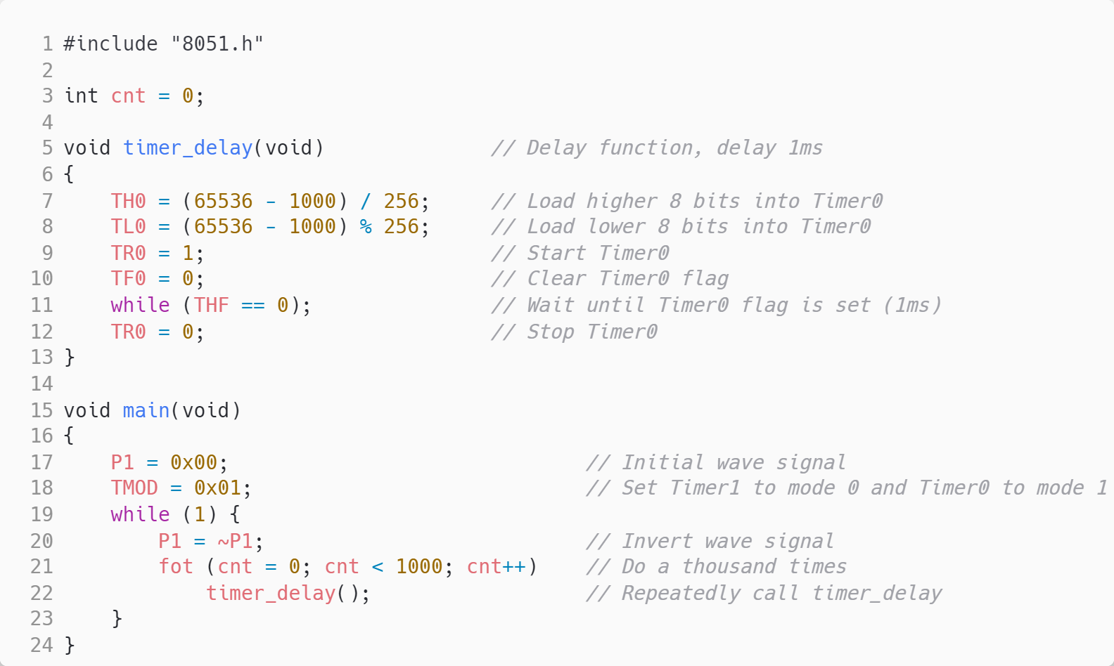
Generate a square wave of 2ms
(Polling)

Slide 15
Reference
https://www.electronicwings.com/8051/8051-timers
https://www.slideshare.net/ishonp98/8051-timers-and-counters
http://dns2.asia.edu.tw/~rikki/mps107/mcs-ch07.pdf
http://tw.classf0001.uschoolnet.com/css000000183803/cm4k-1358643211-5690-3573.pdf

Slide 16
Microprocessor Systems
Lab4 – 2 Hall Magnetic Sensor
Prof. Ren-Shuo Liu
NTHU EE

Slide 17
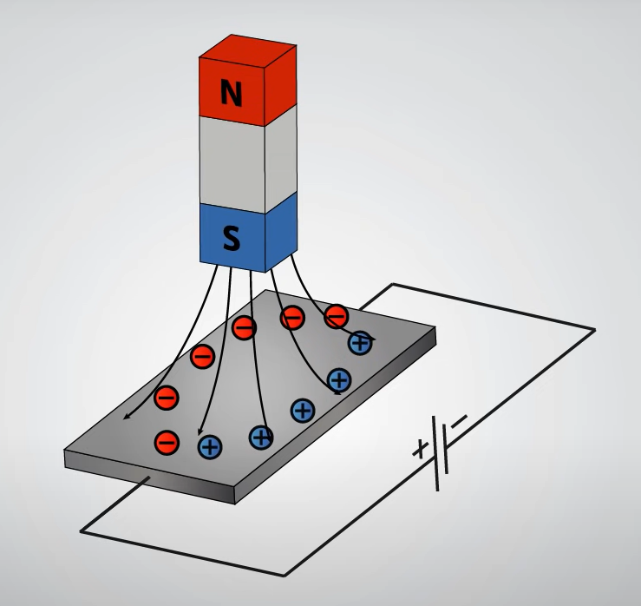
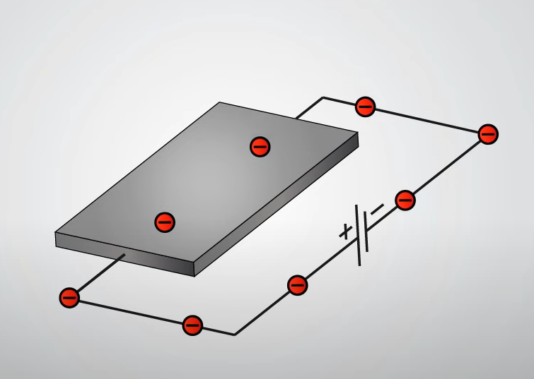
Hall Effect
Discovered by Edwin Hall in 1879.
When magnetic flux goes through a conductive plate, it separates the positive and negative charges, creating Hall voltage.

Slide 18
Hall Magnetic Sensor
A Hall magnetic sensor is a device which is activated by external magnetic fields.
It converts the magnetic flux density around it into output voltage (Hall voltage), which is usually a few micro Volt per Gauss.
Hall sensors usually consist of a thin piece of rectangular p-type semiconductor material, where the Hall effect takes place.

Slide 19
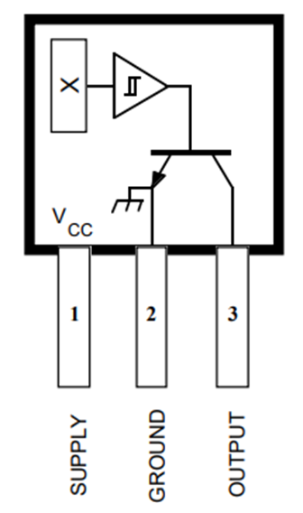
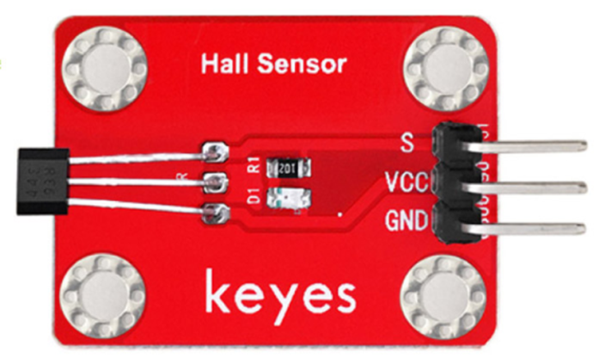
Hall Magnetic Sensor
In this course, we use
Hall Magnetic Sensor A3144E.
Notes:
Order correct?

Slide 20
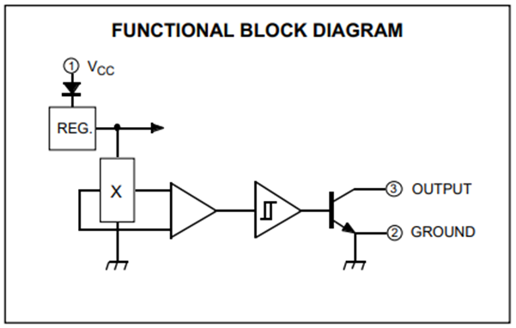
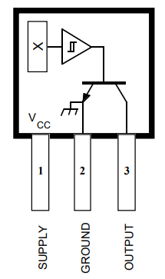
Block Diagram
Schmitt trigger
Analog signal
Digital signal

Slide 21
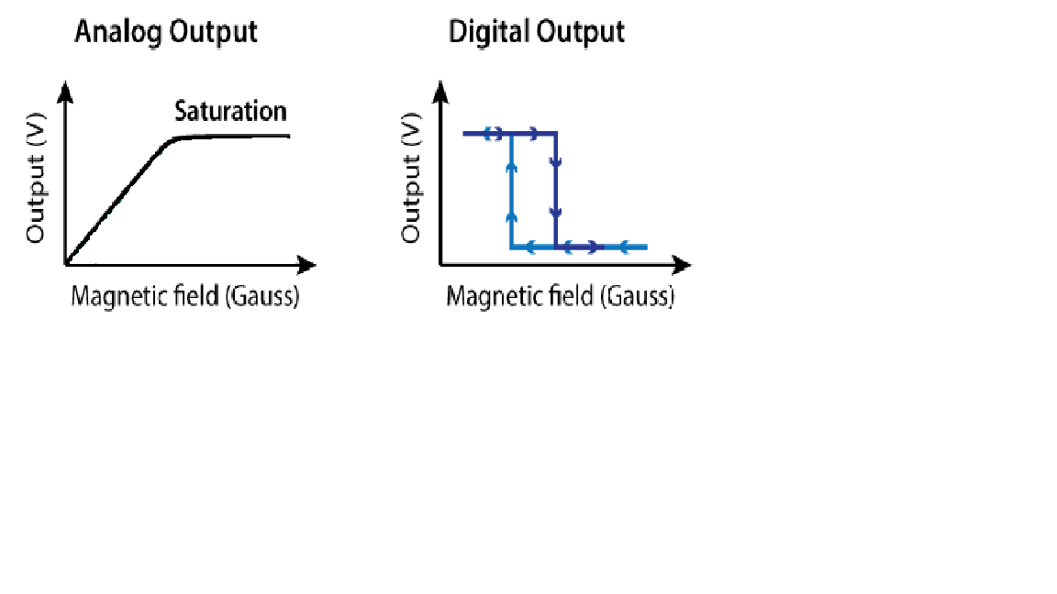
Types of Hall Effect ICs
Linear output type: Used to obtain an output voltage that is directly proportional to the magnetic field strength.
Switching type: Used to obtain an on/off signal.

Slide 22
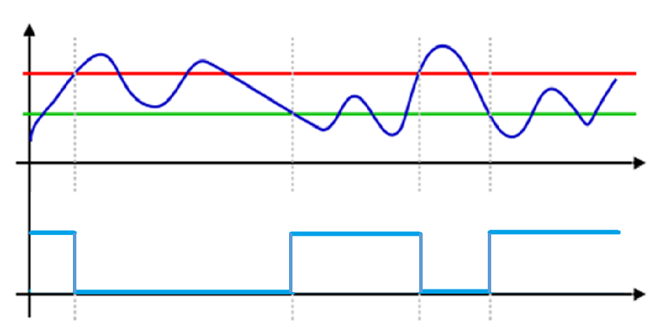
Schmitt Trigger
Input signal > Positive threshold: Output signal = 0
Input signal < Negative threshold: Output signal = 1
Input signal
P_{Th}
N_{Th}
Output signal
1
0
1
0
1

Slide 23
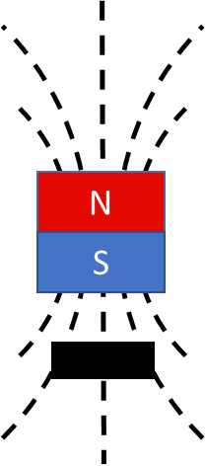
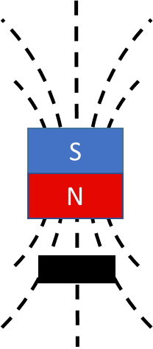
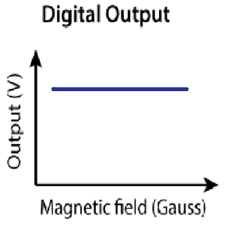
Type of Hall Effect IC Detection
Unipolar Detection
  Only one magnetic field pole (north or south) is detected.
  ON/OFF operation is performed according to the magnetic flux density to output a high or low level signal.
Hall Effect Sensor

Slide 24
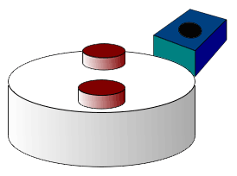
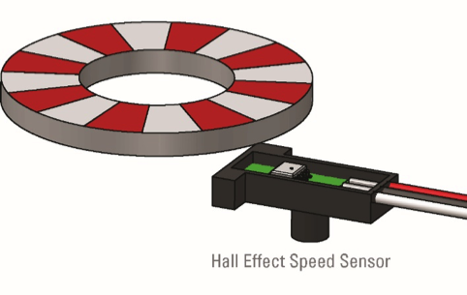
Applications of Hall Effect Sensors
Proximity sensing
Positioning
Speed detection
Current sensing
A rotating 16-pole ring magnet
Red (north pole) : Activate
White (south pole) : Deactivate
→ resulting in a very accurate speed signal

Slide 25
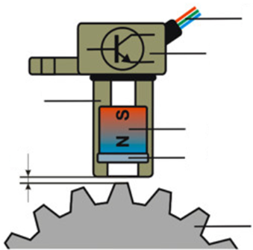
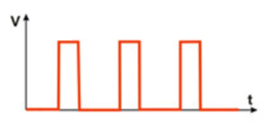
Applications of Hall Effect Sensors
Wheel speed sensors – RPM
The frequency increases proportionally to rpm
Output wires
Permanent Magnet
Gap
Hall Effect Sensor
T
Trigger Wheel

Slide 26
Reference
https://www.allaboutcircuits.com/industry-articles/a-guide-to-the-applications-of-hall-effect-and-reed-switch-sensors/
https://www.electronics-tutorials.ws/electromagnetism/hall-effect.html
https://www.ablic.com/en/semicon/products/sensor/magnetism-sensor-ic/intro/
https://howtomechatronics.com/how-it-works/electrical-engineering/hall-effect-hall-effect-sensors-work/
https://www.linkedin.com/pulse/inductive-hall-effect-rpm-sensors-explained-kiril-mucevski?trk=mp-author-card

Slide 27
N
S
S
N

